Slide 1
Attendance Recording System
based on Face Detection and Face Recognition
Reporting time：May 2020
By
Shibo Yao,Xiangang Lai, Yifan Yang

Slide 2
Problem Tracking
The idea of our project is that professor need read out our name to take attendance. The project is that we want to create a system that can auto take attendance based on students face comparing to the students’ picture that stored in the system.
Our project is going to use Deep convolutional adversarial network. We will use two methods, which are Convolutional Neural Network and Generator network.
We want to achieve the goal step by step: face picture detective, multiple face picture detective, real world face picture Recognition, multiple real world face Recognition and taking data to calculate for taking attendance.

Slide 3
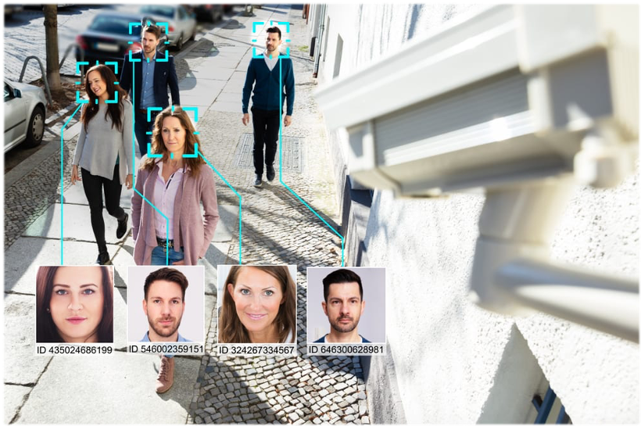
Appearance
Where is the data from
We will store pictures of each participant as a database.
After recognizing the face of each attendee, compare with the person who should be present in the database

Slide 4
Related Work
Face detection:
Face detection has become a subject that is widely valued and actively researched in the field of pattern recognition and computer vision.
Convolutional Neural Network:
  In deep learning, a convolutional Neural Network is a class of deep neural networks, most commonly applied to analyzing visual imager
Generative Adersarial Network:
A generative adversarial network (GAN) is a class of machine learning systems invented by Ian Goodfellow and his colleagues in 2014

Slide 5
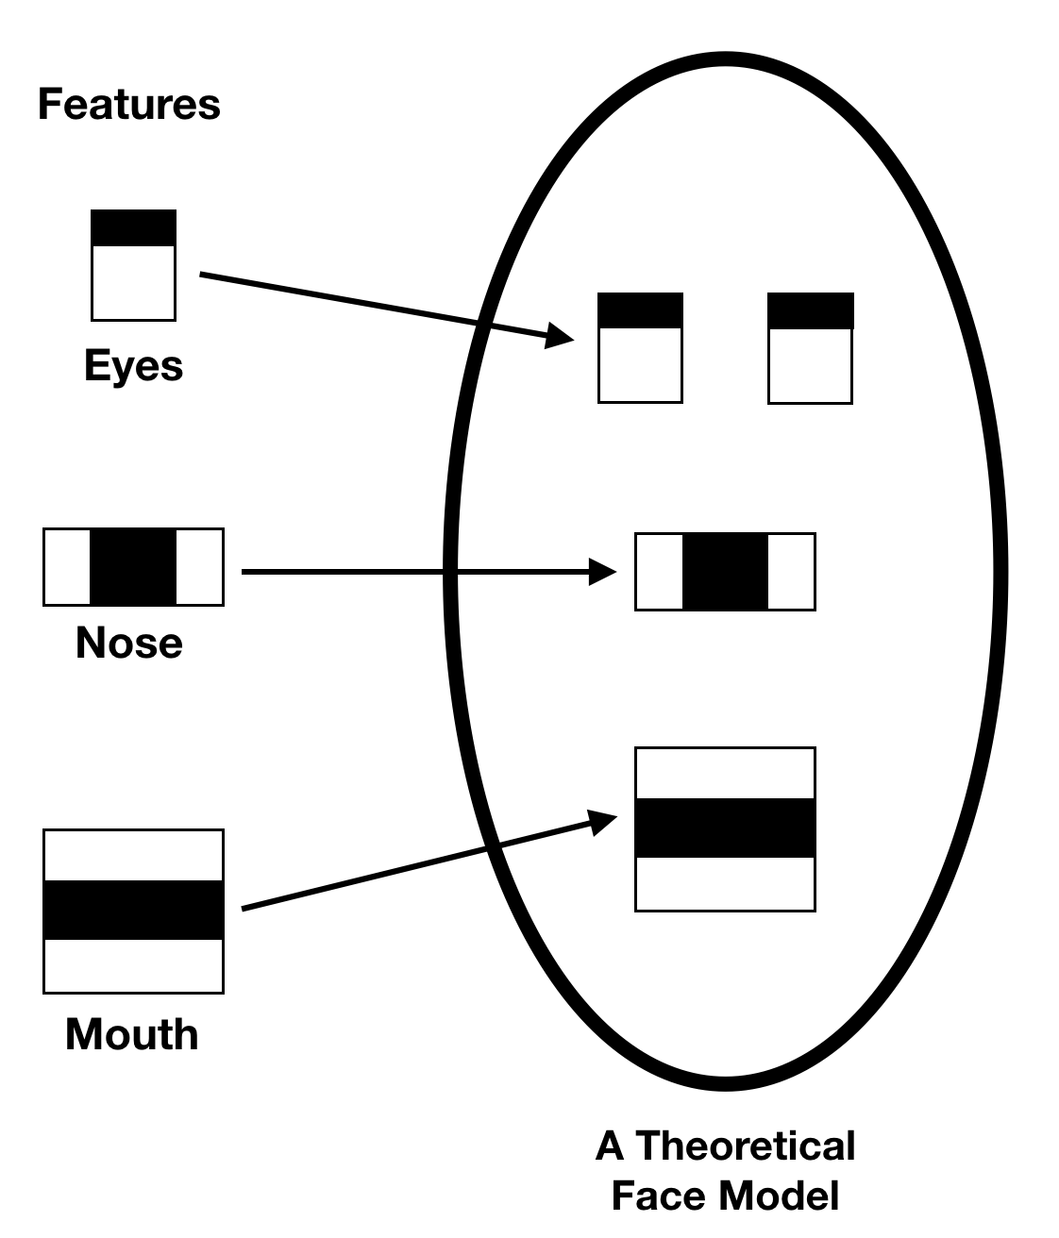
How to Approach
Real-time Face detection with OpenCV.
We will use the Haar Cascade Classifier algorithms in OpenCV. Harr Cascade Classifier is very popular algorithm for object detection.
Notes:
First, we input an image or video frame to our face recognition pipeline. Given the input image, we apply face detection to detect the location of a face in the image.
Optionally we can compute facial landmarks, enabling us to preprocess and align the face.
Face alignment, as the name suggests, is the process of (1) identifying the geometric structure of the faces and (2) attempting to obtain a canonical alignment of the face based on translation, rotation, and scale.
While optional, face alignment has been demonstrated to increase face recognition accuracy in some pipelines.
After we’ve (optionally) applied face alignment and cropping, we pass the input face through our deep neural network:

Slide 6
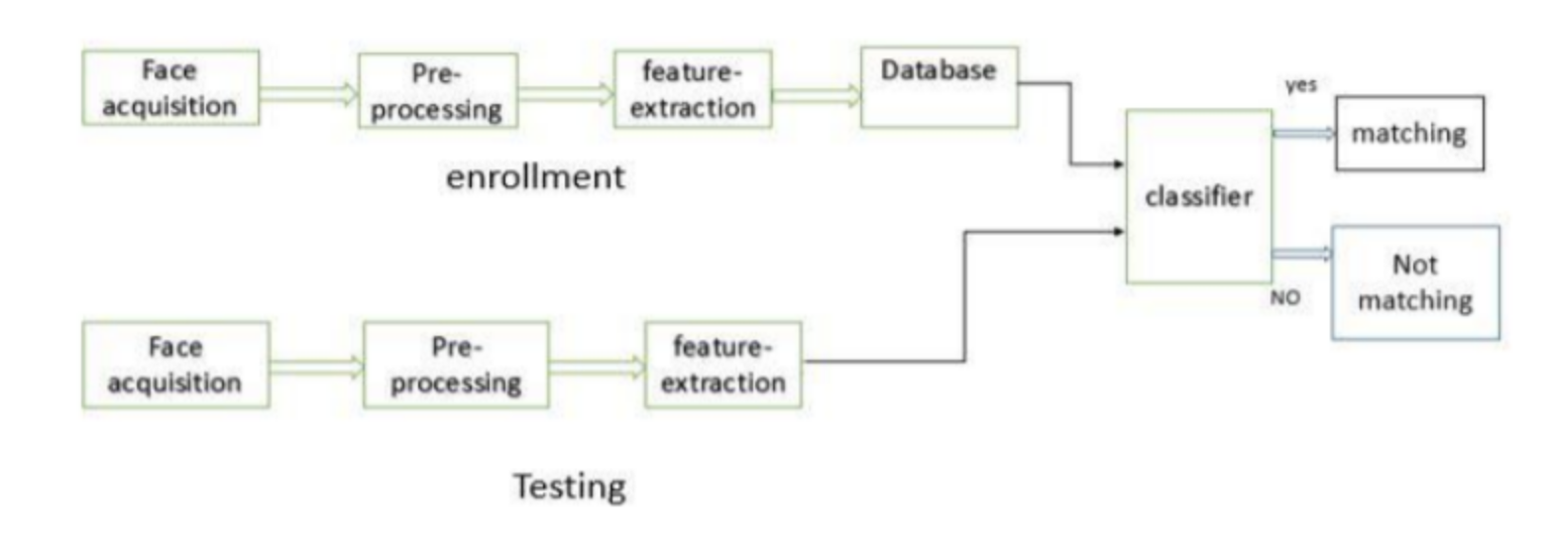
How to Approach
LBPH Face Recognizer.
LBPH: Local Binary Patterns Histogram algorithm was proposed in 2006. It is based on local binary operator. It is widely used in facial recognition due to its computational simplicity and discriminative power.

Slide 7
Related to our Class
From Assignment 1&2, we are doing data analysis with picture using different supervised learning algorithm.
Citation
https://iq.opengenus.org/lbph-algorithm-for-face-recognition/
https://www.pyimagesearch.com/2018/09/24/opencv-face-recognition/
https://medium.com/@soumyapatil031/face-and-eyes-detection-using-opencv-9fcad47656a4

Slide 8
THANK YOU
Have a good night!

